Slide 1
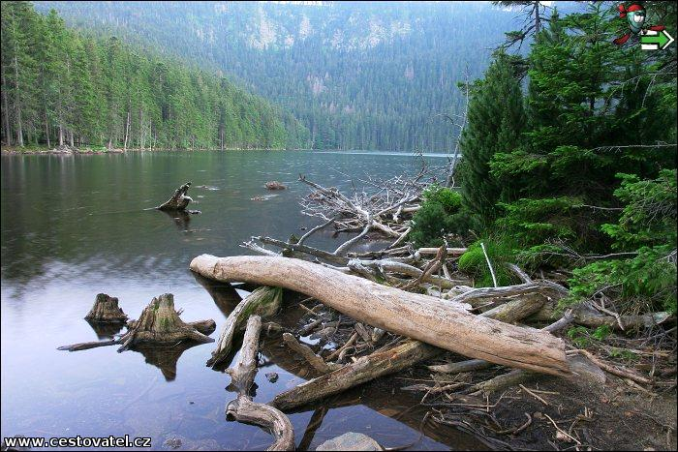
Superlatives in the Czech Republic

Slide 2
Hello from our house again! We successfully arrived from Prague and now we want to show our German friends some interesting facts about Czech Republic. Join us!

Slide 3
Hans, Susan! We´ve got an interesting views of our country for You! Come here!
Ok! We´re just coming, Martin! Hans, come to the living room!

Slide 4
First we want to show You this mountain in „Krkonoše mountains“.
Do You know its name?

Slide 5
Right! It is „Sněžka“ mountain and it keeps more superlatives, look:
The highest mountain in Czech
republic- 1602 m above sea level
2. The strongest wind was measured
there- 216km/h!
3. The lowest avereage temperature,
the coldest place in Czechia- 0,4 degree
Celsius.

Slide 6
We are still close to Sněžka mountain. These waterfalls called „Pančava“ are the highest in our country, their height is 148 metres.

Slide 7
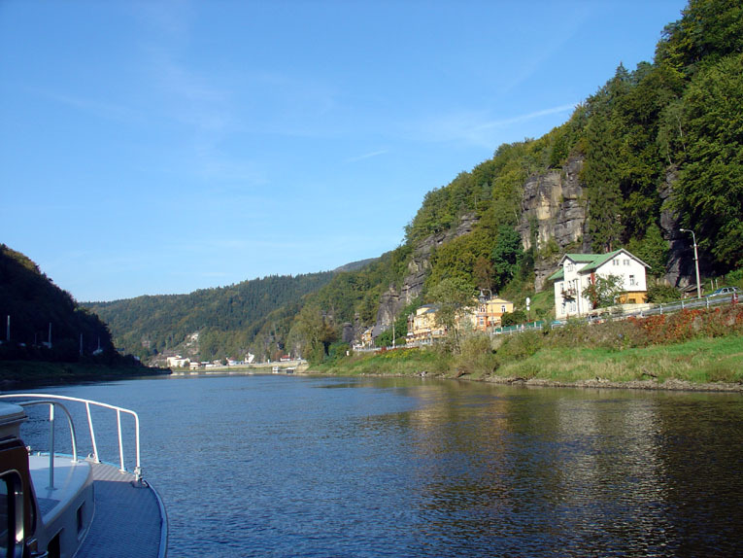
What a picturesque valley!
Would You like to be here with me on this boat?
Try to guess, what´s the name of this river!

Slide 8
In contrast, this is the lowest place in Czech republic- „Hřensko“ near German border . It´s 116 metres above sea level. You know it very well! Our widest river „The Elb“-“Labe“, which streams under Sněžka mountain and has the biggest average flow- 306 m3 per second .

Slide 9
Let´s stay in the nature. We moved to another part of Czech republic, to the south-western part, where we can find the largest National park- Šumava.

Slide 10
Šumava is the place of wild nature in our country.
There are deep forests,Beautiful sceneries,
natural lakes full of fish in clear water and also
dangerous moor, where a few people disappeared.

Slide 11
This is the largest natural lake , „Černé“ (black) lake.

Slide 12
Černé lake in Šumava is the largest in Czech republic.
It has an area of 18,4 hectars and is also the deepest one.
Its maximum depth is 39,8 meters.

Slide 13
In Šumava national park also streams our most beautiful and longest river- Vltava. Vltava flows to the North during all Bohemia, then in Mělník flows into the Elb.
This is the largest dam on Vltava river- Lipno. It covers 48,7 square kilometers.

Slide 14
Orlík dam is the dam with the biggest volume of water. It has 704 000 000 square meters of water!
Watch on this beautiful castle with the same name- Orlík.

Slide 15
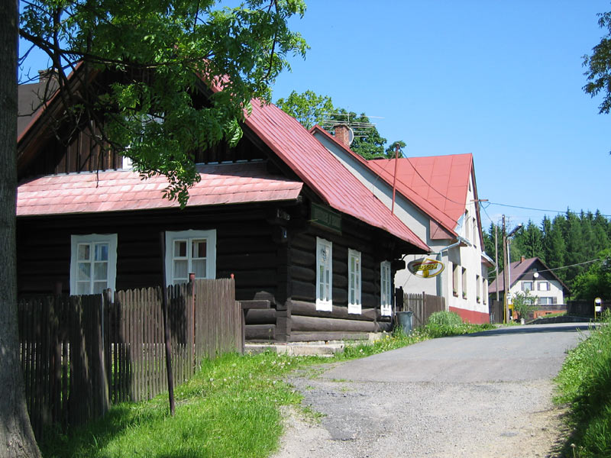
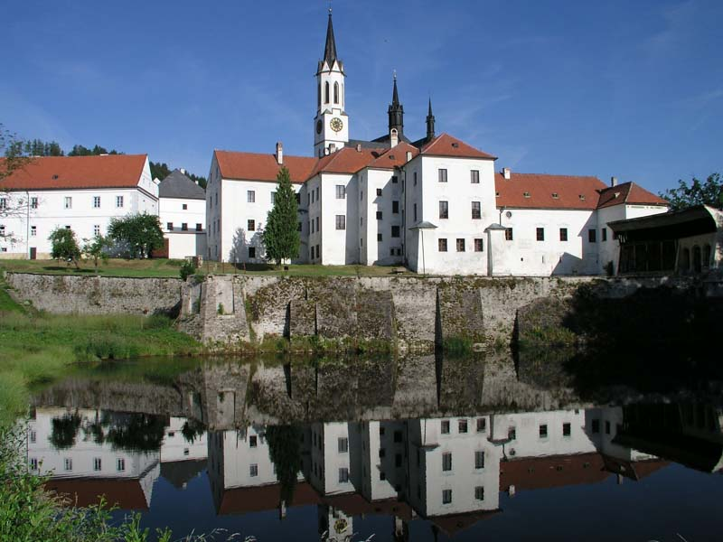
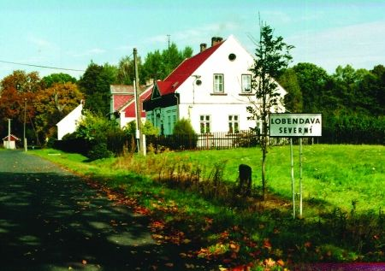
These are four communities, which lay near four border ends of Czech republic. Can You put the right world sites to these pictures?

Slide 16
The most Northern
The most Southern
Hrčava
Aš
The most Eastern
The most Western
Vyšší Brod

Slide 17
In opposite to Sněžka, Klementinum in Prague is the warmest place in our country. It has the highest average temerature: 10,1 Celsius degree.

Slide 18
The graph of average temperatures in Klementinum, Prague

Slide 19
I would like to show You the highest man-made point in Czech republic: transmitter on Praděd in Jeseníky, it is1653 above sea level.

Slide 20
And the deepest cave „Býčí rock“
About 200 meters deep.

Slide 21
These are the distances from Czech republic to the seas.

Slide 22
And the oldest building here- The Roman church of St. Peter and Paul in Budeč. It is eleven centuries old.

Slide 23
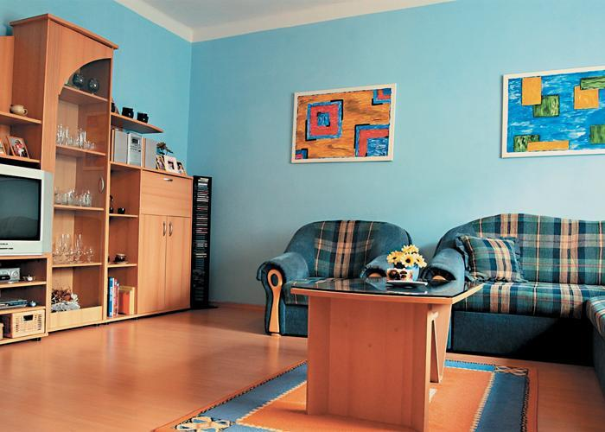
Thank You, Martin and Jana! Czech republic is really wonderful!
Yeah, it was wonderful!

