Slide 1
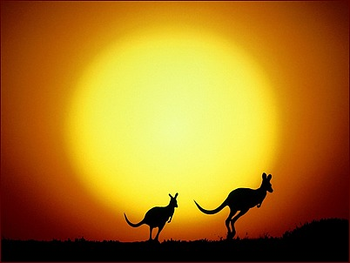
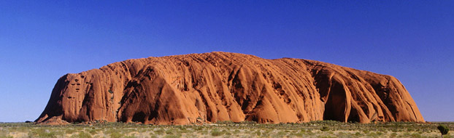
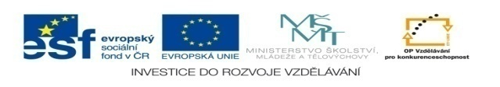
GOOD DAY, AUSTRALIA !

Slide 2
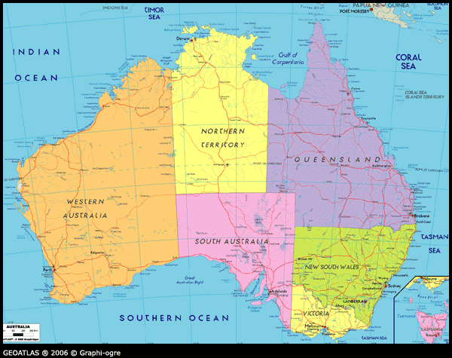
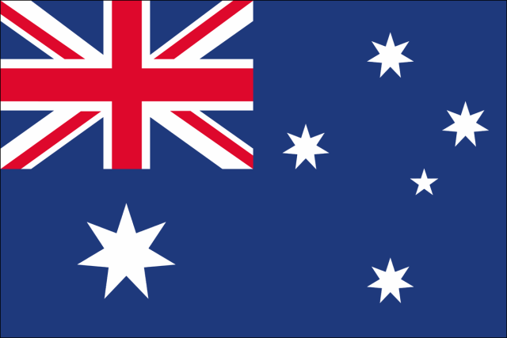
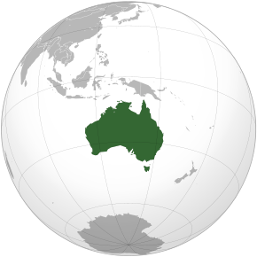
Australia, officially the Commonwealth of Australia, is one of the largest states in the world and also the smallest continent, situated in the southern hemisphere. It includes the island of Tasmania and a number of other smaller islands. The capital is Canberra. In Australia there are approximately 22 million people, mainly in the large coastal cities such as Syndney, Melbourne, Brisbane. It is situated at 7.5 million square kilometers. It is headed by the British monarch, which represents the country's Governor General. The land consists of six states and two territories.
Notes:
Hemisphere- polokoule
Approximately-průměrně
Commonwealth-společenství
Headed-stát v čele, vládnout

Slide 3
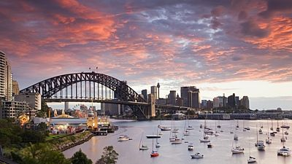
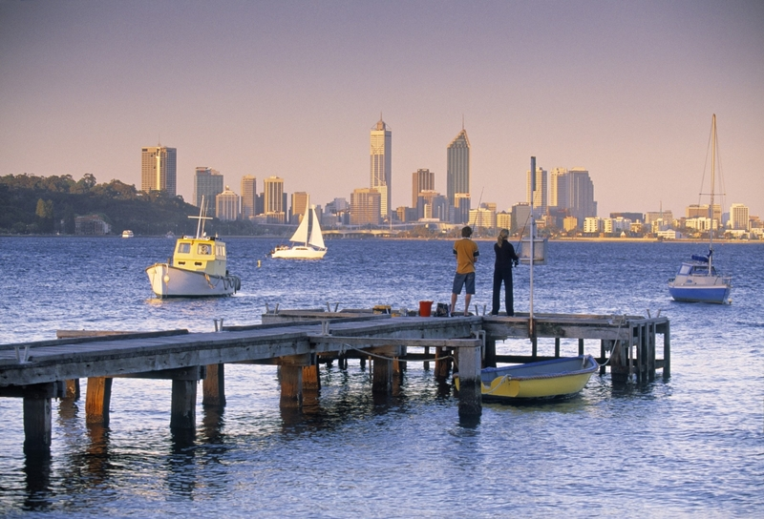
The major resorts are on the coast. For example Sydney has 4,5 million inhabitants, which means 15 times more, than live in Australian capital Canberra.
The distribution of population in Australian continent is disbalanced, one sq. kilometer live only 3 people, which makes Australia one of the lowest rungs in the population. Nearly half the population lives in Syndney and Melbourne.
Notes:
15 times- patnáctkrát

Slide 4
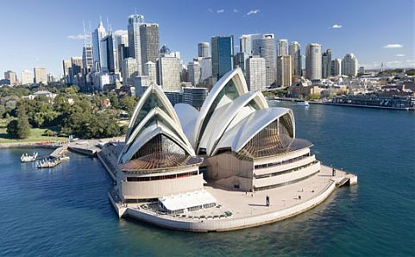
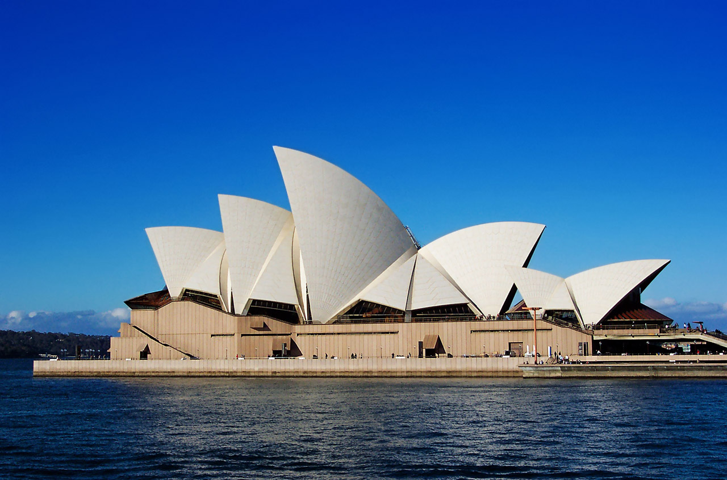
The official language is English, because it was a colony of United Kingdom. The most inhabitants come from Great Britain too.
In 18 century arrived many prisoners to start a new life there.
This Opera is in the shape of stretched sails. It is well known over the all world.

Slide 5
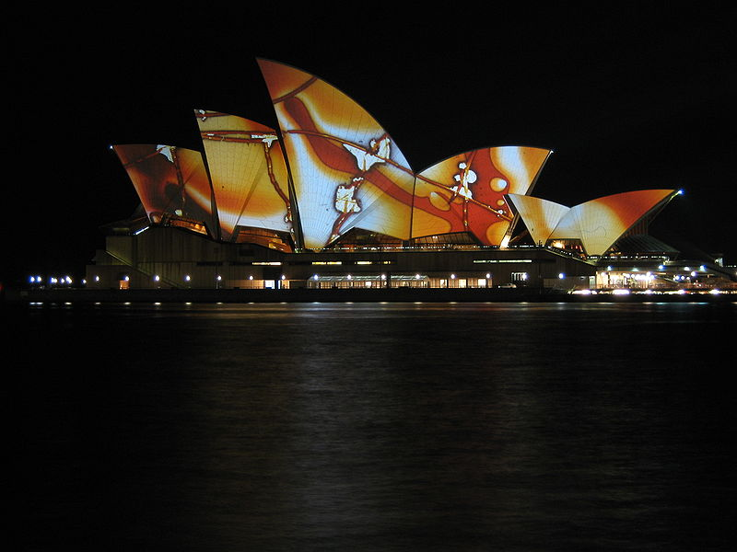
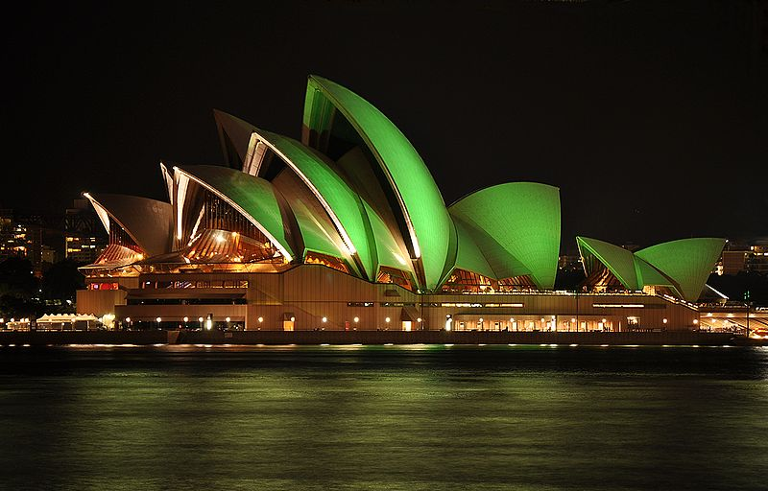
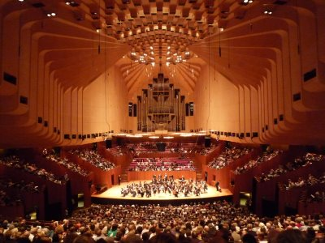
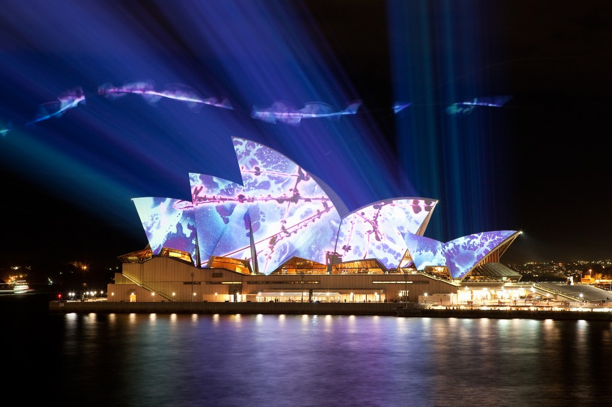
The magnifician building of the Sydney opera.

Slide 6
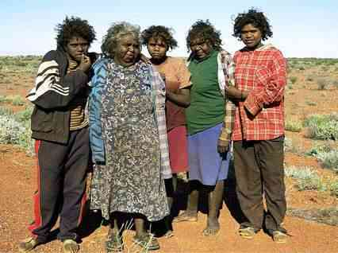
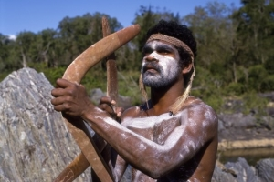
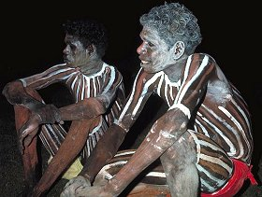
Native weapon- bumerang.
The original inhabitants are Autralian aboriginals. These natives suffer from poverty and discrimination. They live about 15 years less than the general population because of sniffing petrol very often. Many Aboriginal paintings can be found on the walls of rocks and caves
Notes:
Suffer- trpí
Sniff-čichat

Slide 7
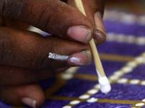
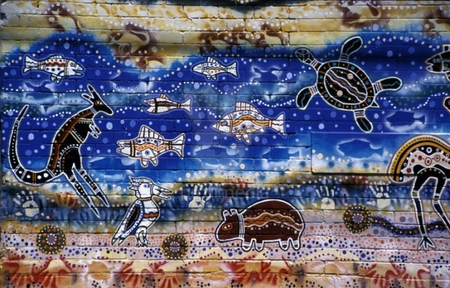
Original paint of Australian natives.

Slide 8
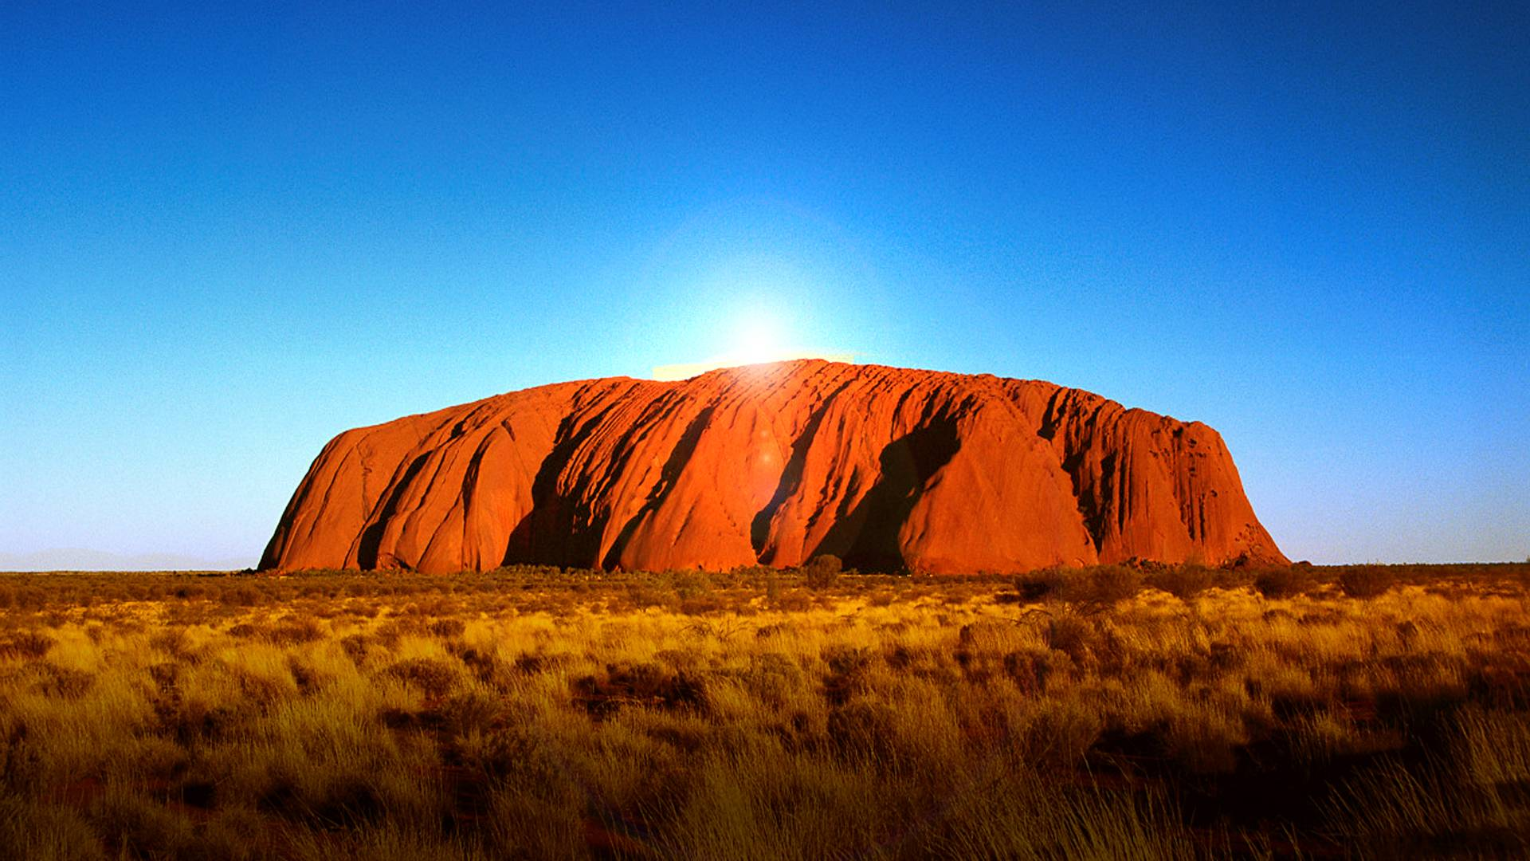
Ayers Rock, or Uluru is a sandstone formation located directly in the center of Australia's indigenous territory. It is the most voluminous monolith in the world. Ti reaches the height of 348 m above the surrounding landscape, but extends to 5 km deep! It is 3.6 km long and 2.4 km wide. For natives, it is very important place.
.

Slide 9
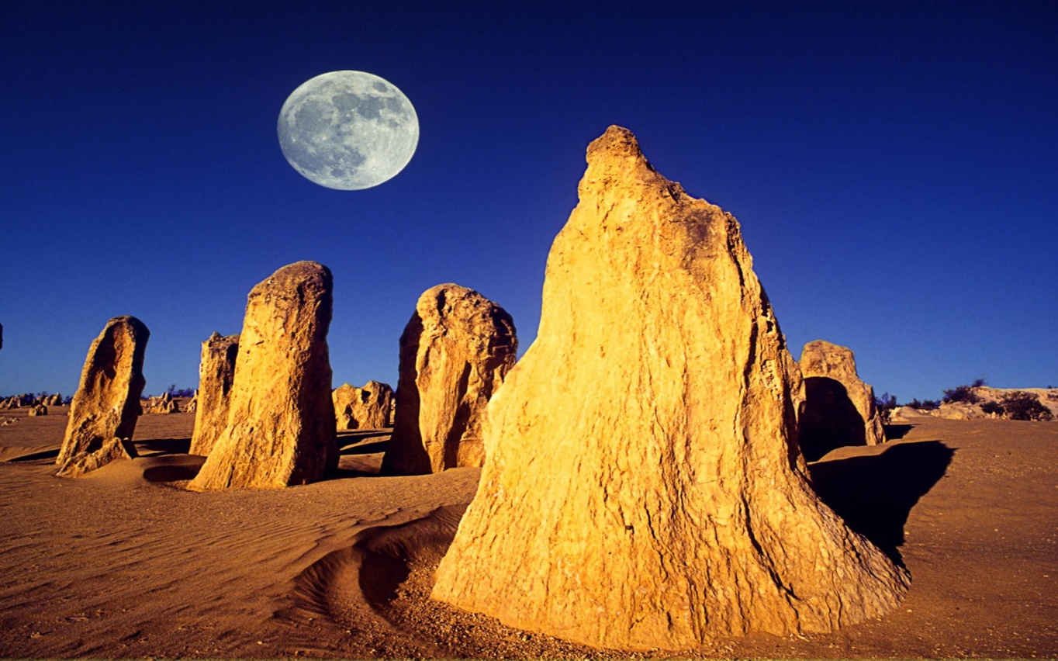
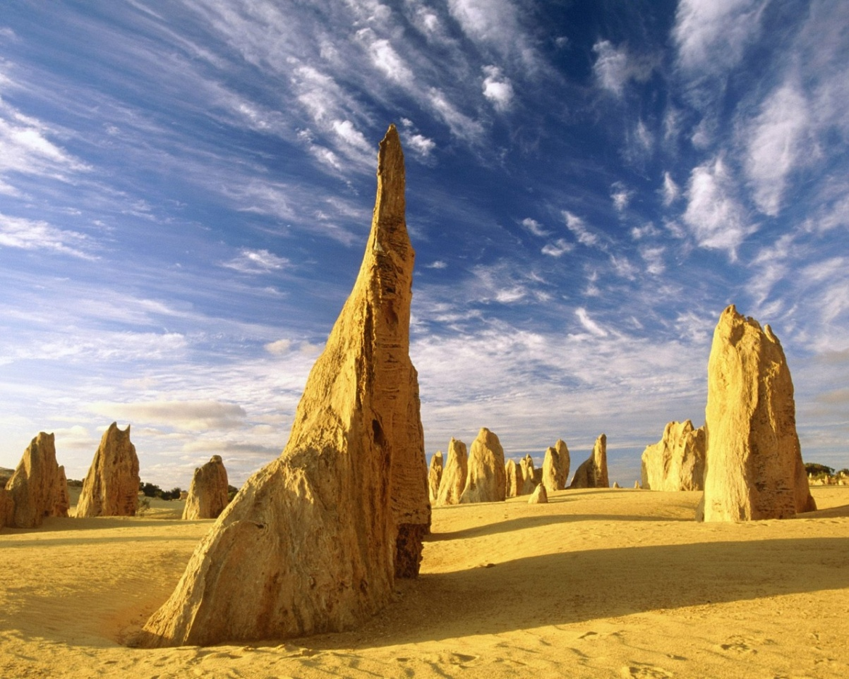
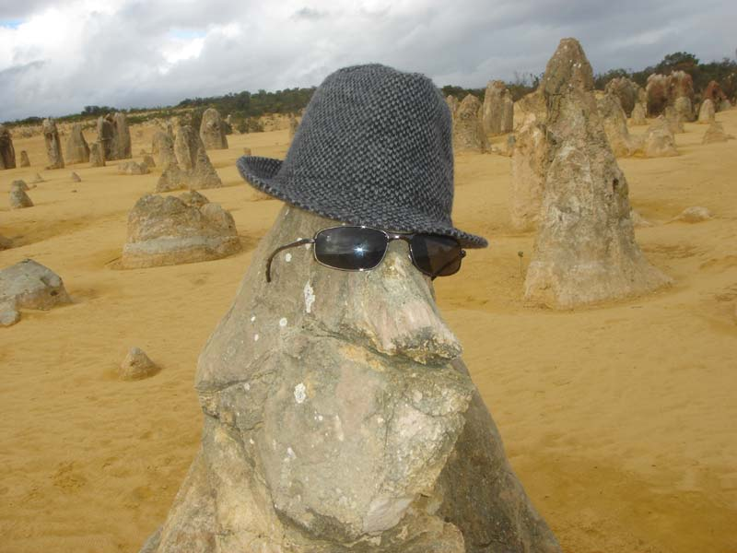
Another attraction is the Pinnacles Desert - moonscape with up čtyřmetrovými limestone pillars.
Notes:
Limestone- vápenec

Slide 10
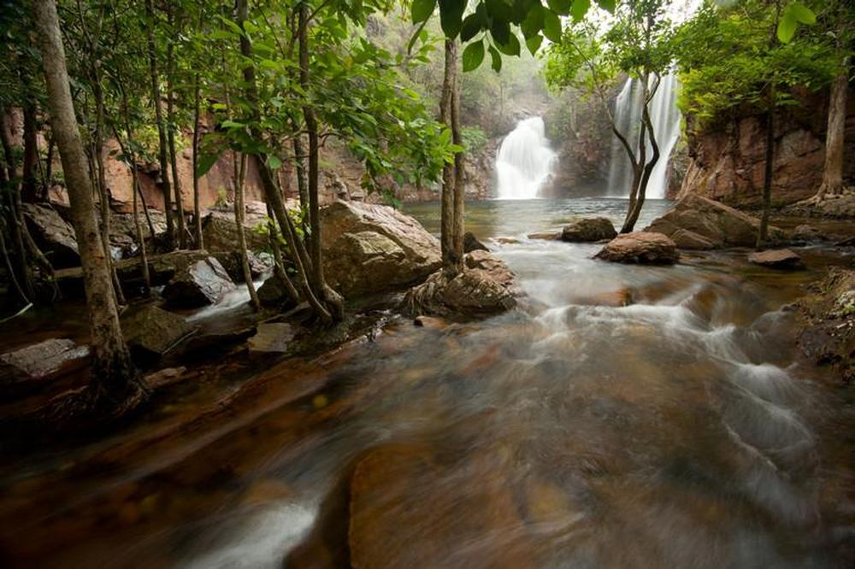
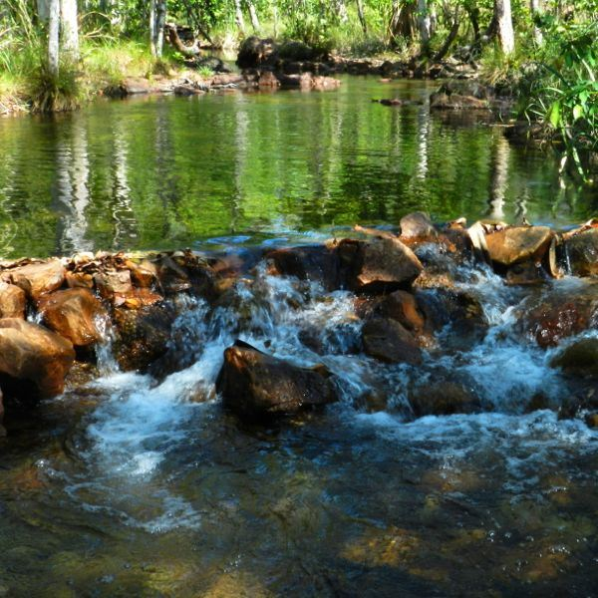
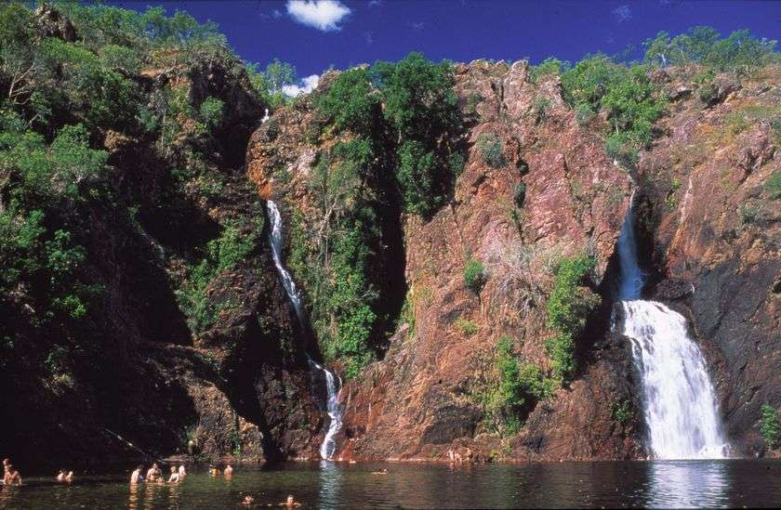
Litchfield is a very attractive tourist National Park with its beautiful waterfalls, lakes and forest.

Slide 11
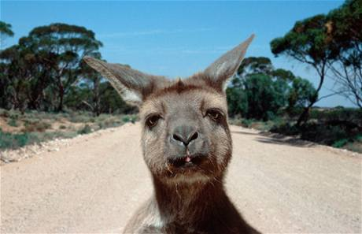
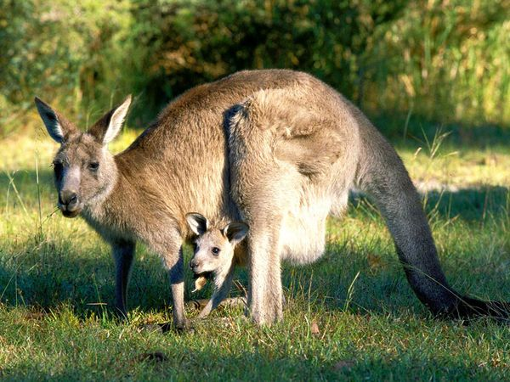
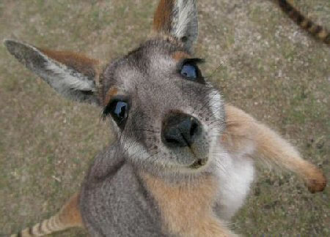
In Australia, there is living a large number of unusual animals that nowhere else in the world exist. The most famous is the kangaroo.

Slide 12
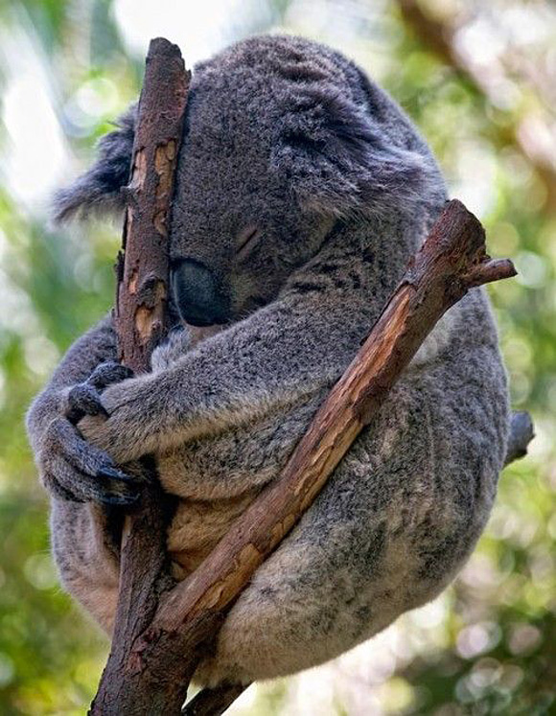
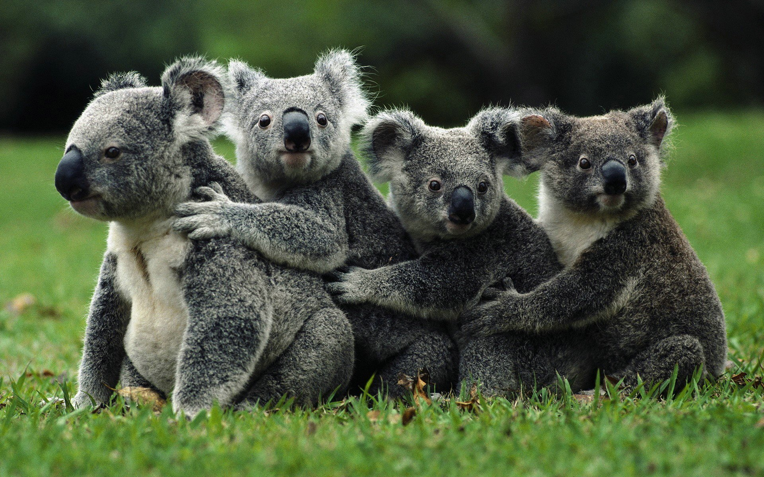
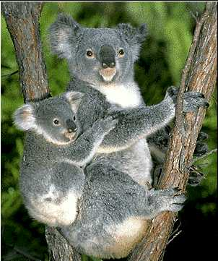
Koala bears

Slide 13
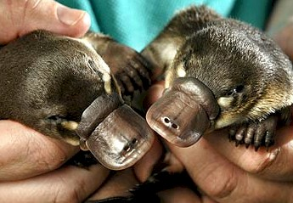
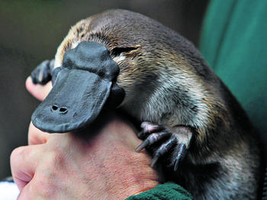
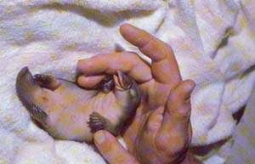
Platypus is one of the strangest creatures in the world. It is a mammal with a duck beak, which, like birds lays eggs, but babies are fed with breast milk.
Notes:
Platypus- ptakopysk
Breast- mateřský

Slide 14
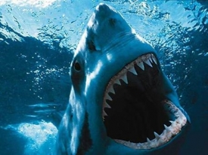
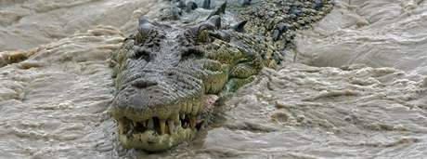
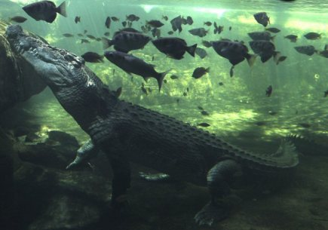
Sharks threaten the coast of Australia.
The most dangerous crocodiles are the sea crocodiles, which live in the North of Australia. They reach the length of 9 meters and 1 tonn weight. They are extremely dangerous for people.

Slide 15
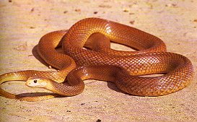
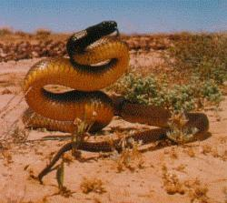
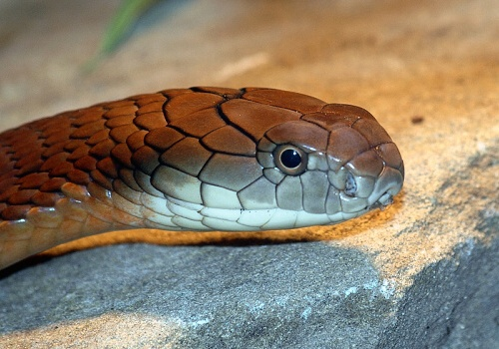
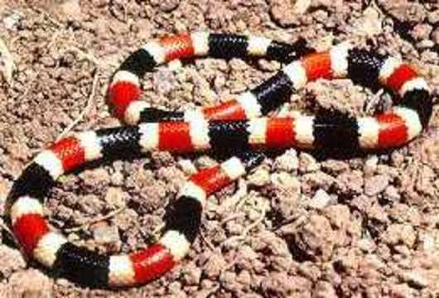
Australia is the first place in the number of poisonous snakes. There live 143 kinds of poisonous snakes, which include Taipan. It´s single bite can kill up to 80 people.

Slide 16
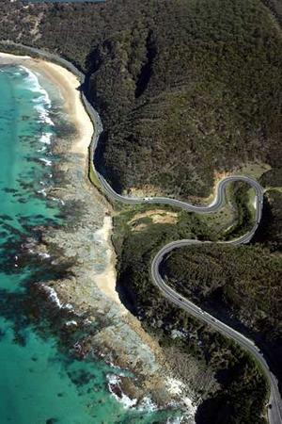
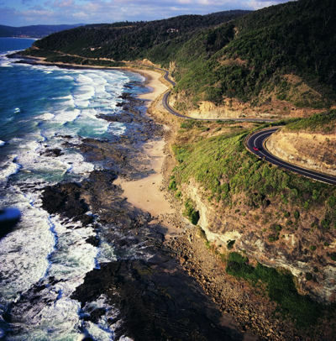
Pride of Australia is Great Ocean Road - a 243 km long part of road along the southeast coast. It is a war memorial, soldiers built between 1919 to 1932 dedicated to the victims of war.

Slide 17
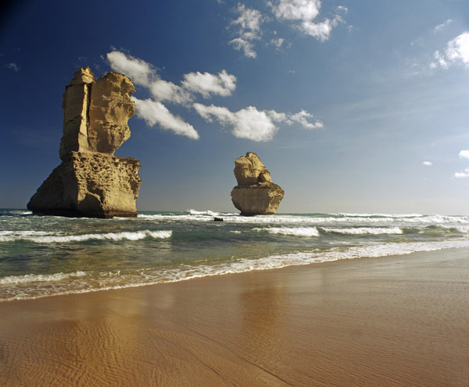
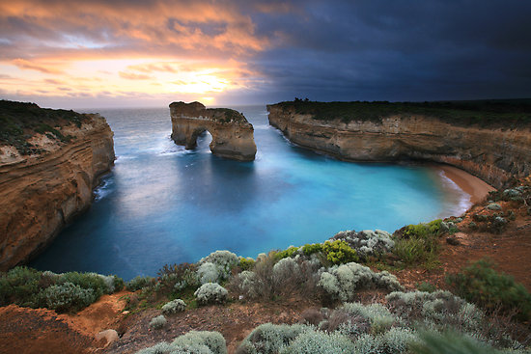
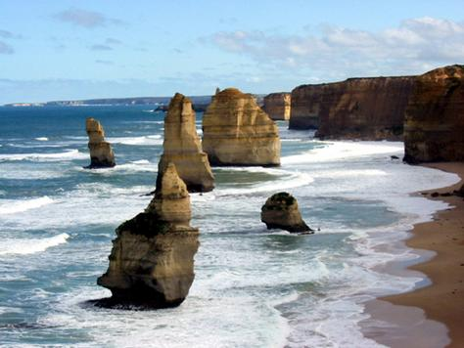

Slide 18
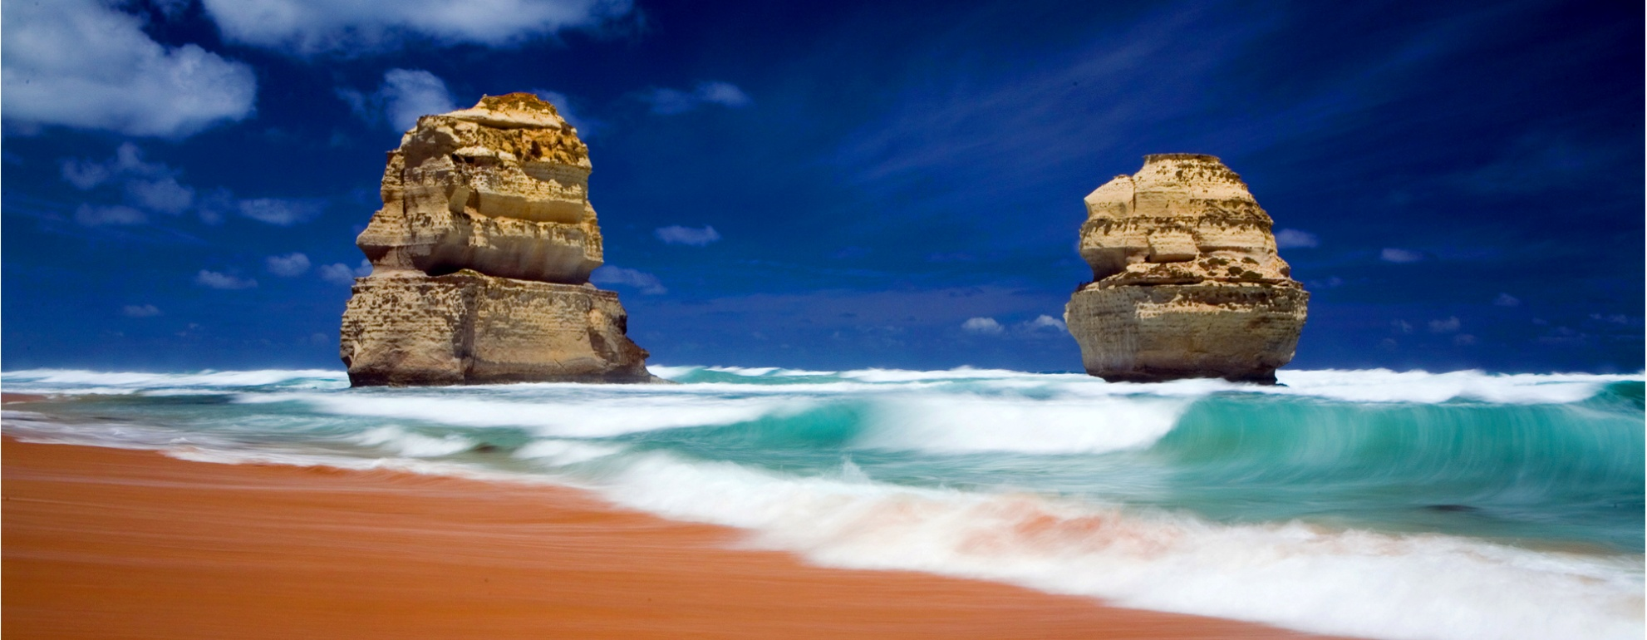
GOOD BYE!

