Slide 1
We like music!

Slide 2
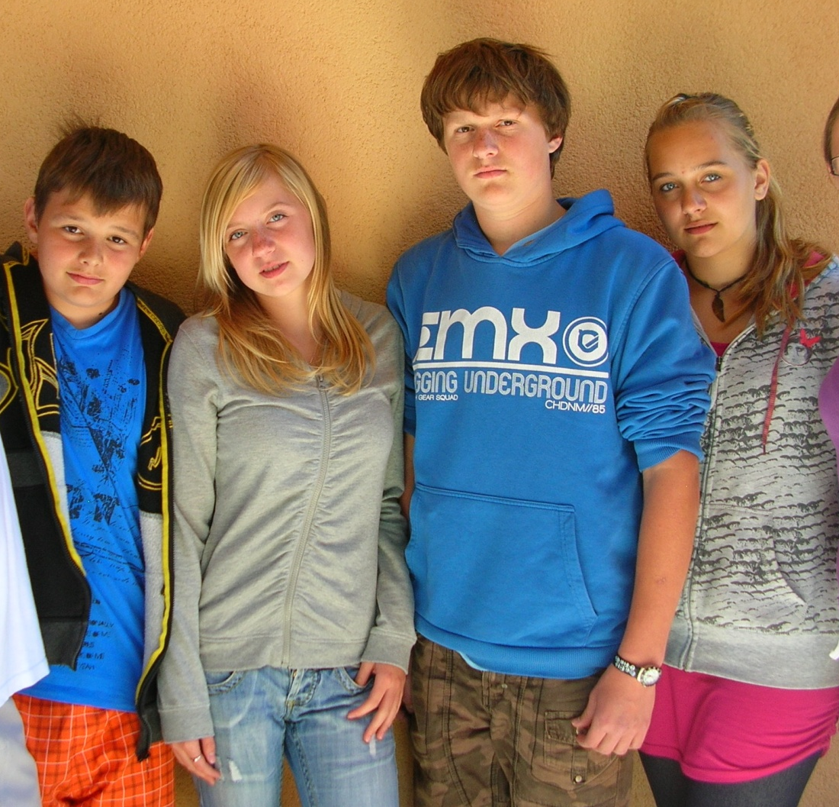
Children are in the living room. They are talking about their favourite singers and music groups. Each of them is going to tell us something about his favourite one.
Music refreshes me !
Music is important part of my life.
Hey, boys and girls, let´s talk about music today!

Slide 3
My favourite pop group is called „Pussycat dolls“. I love listening their music, because it´s full of joy and energy! Their music refreshes me. I like their style of fashion- it´s trendy and fashionable. They have really unforgetable image!

Slide 4
Maybe You know, that our town- Dresden is very famous place of classical music concerts. People from all Europe travel to Dresden to listen the best musicians who perform the most famous music from Johann Strauss, Ludwig van Beethoven, Johann Sebastian Bach or Gregor
Friedrich Handel in these beautiful churches and palaces. It´s really beautiful experience, my parents love it! You know, I also listen to popular music, I like Seal and Michael W. Smith.

Slide 5
As I told You, my favourite singer is Shakira. I have got her poster on the wall in my room. I love her show during concerts, it´s full of energy and good –styled fashion. Her music is very suitable for dancing.
Sure You know this song- it´s my favourite, It´s very good for dancing!

Slide 6
Children, me and Your father like music very much. We often enjoy piano concerts and worship music. My favourite group is Accapella, let´s listen to her song and fill the missing words in the text.

Slide 8
I quite like Czech rock music. For example this rock band. They aren´t so famous, but I like their music and texts about life and troubles.

Slide 9
I like worship music. Hillsong is very famous, they sing christian music all over the world.

Slide 10
List of music styles:
Hello everybody, Surely You know me! I´m Michal David and I recommend You this list of music styles on Wikipedia website, look!

