Slide 1
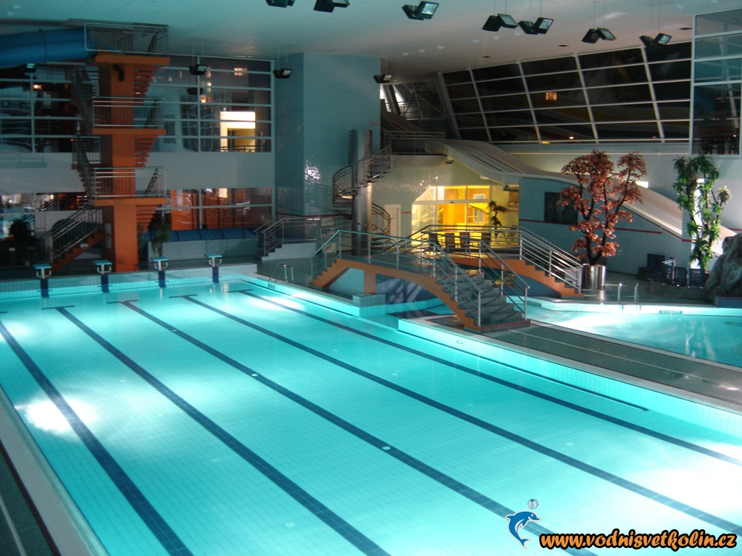

At the swimming pool

Slide 2
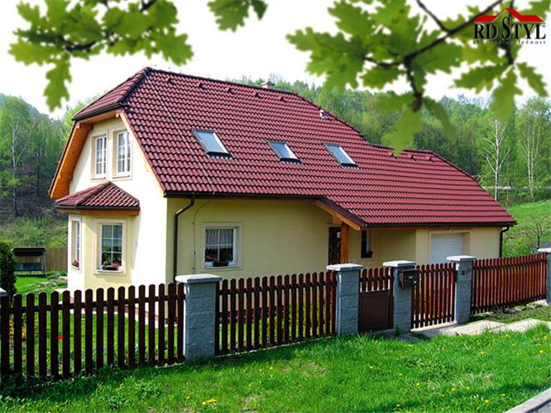
After making the week plan Novák´s family with their guests left to the swimming pool in the town. Children like to be there very much.

Slide 3
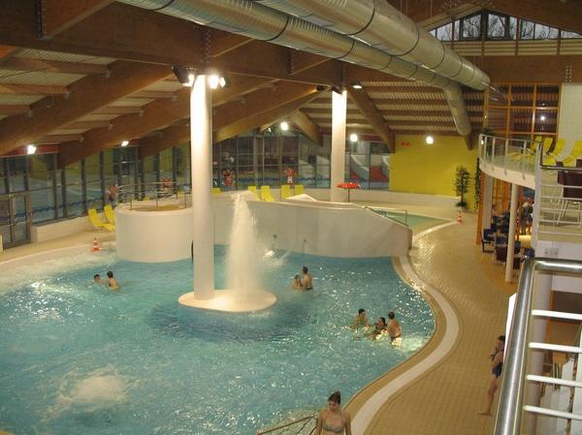
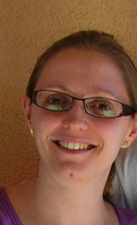
Here we are now. Our children with Susan and Hans started to slide the water tobogans. They like it so much! I´m going to swim in the pool with Jan. I wait for him- he is at the toilet .

Slide 4
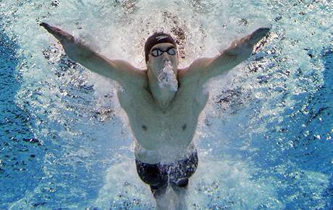
wrist
hand
elbow
shoulder
Marie and me enjoy swimming very much, but both children rather slide or play in the water. They should swim!
finger
leg
chest
knee
arm
stomach
neck
hip
nose
. Describe parts of the body

Slide 5
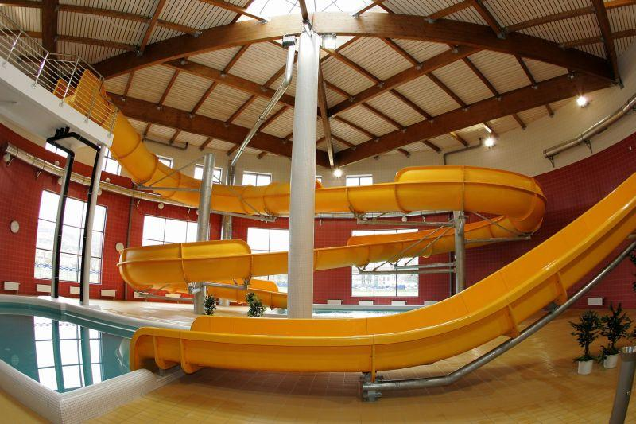
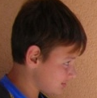
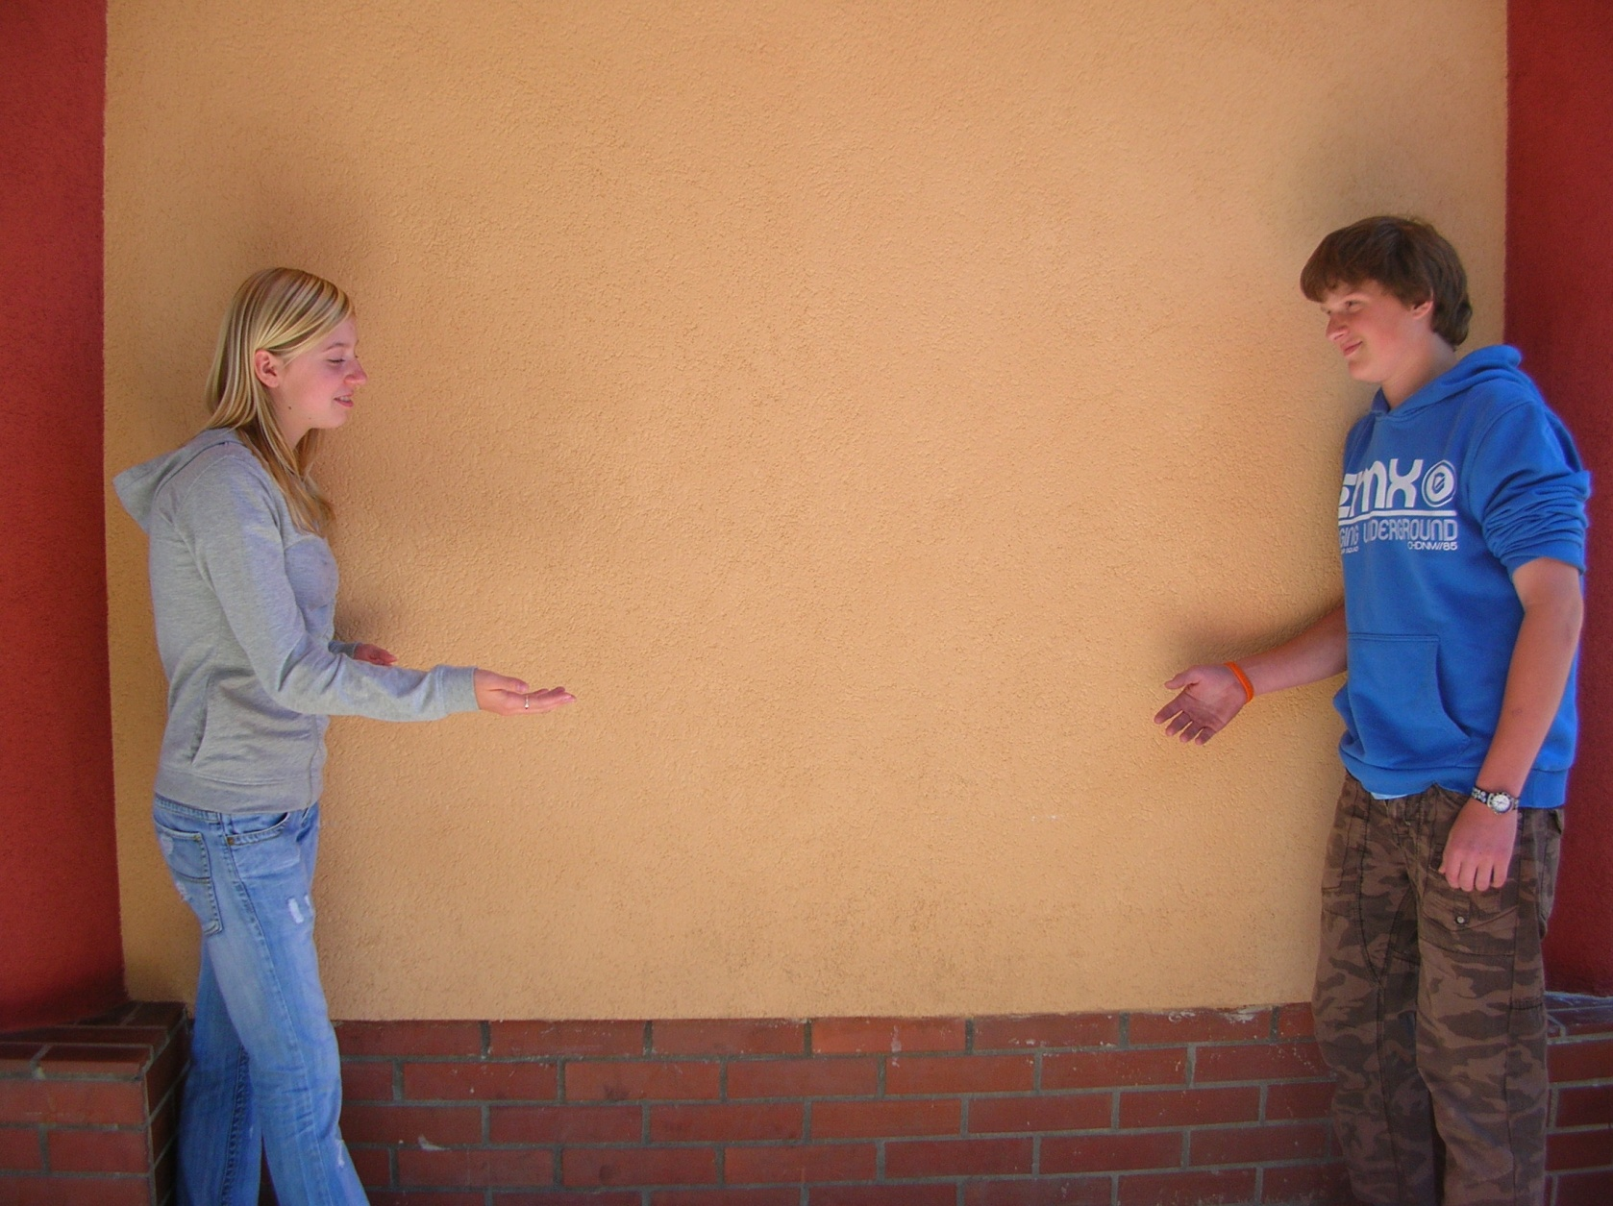
Boys, where are You?
Hey, Hans, it´s absolutely perfect! It´s so fast! Try to use this track!
Ugh! Martin! I´m just falling, it´s super!

Slide 6
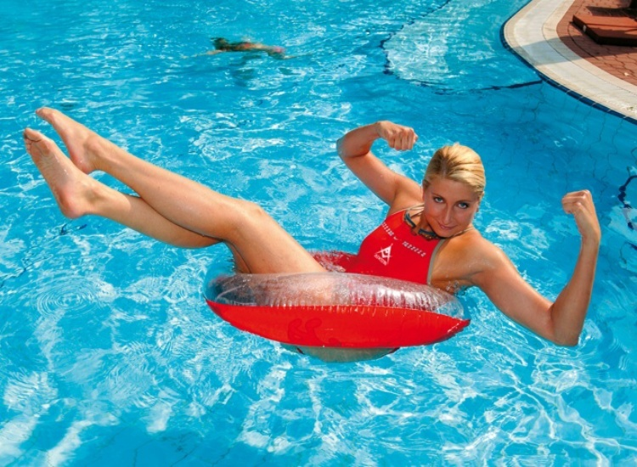
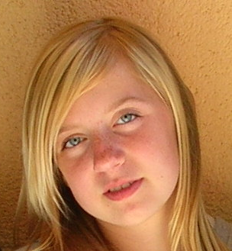
Oh, it´s perfect relax. The water is so clear!
hand
elbow
shoulder
finger
leg
chest
knee
arm
stomach
neck
hip
nose
. Describe parts of the body

Slide 7
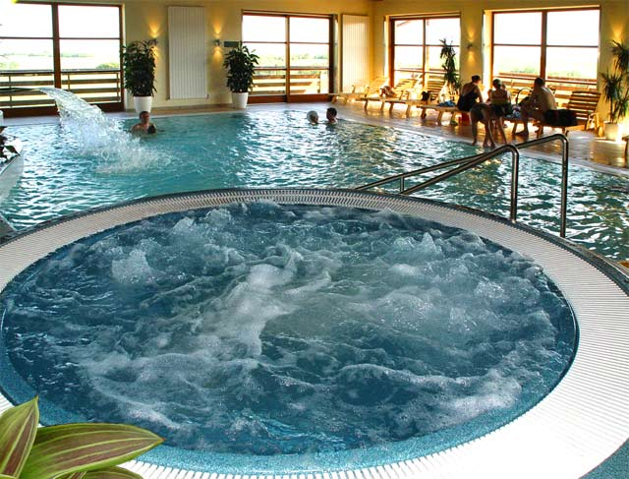

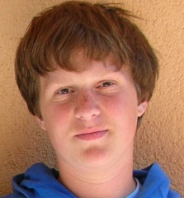
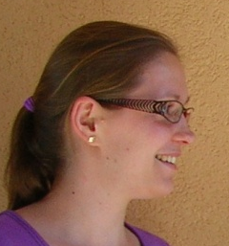
Some nozzles flow hot, some cold water, it´s very special!
It´s perfect massage for all the body- back, legs, neck- very comfortable.
Oh, my legs and arms are vibrating! I can´t hold it!
Hans, it´s O.K., You will adapt on it.
In the whirlpool bath

Slide 8
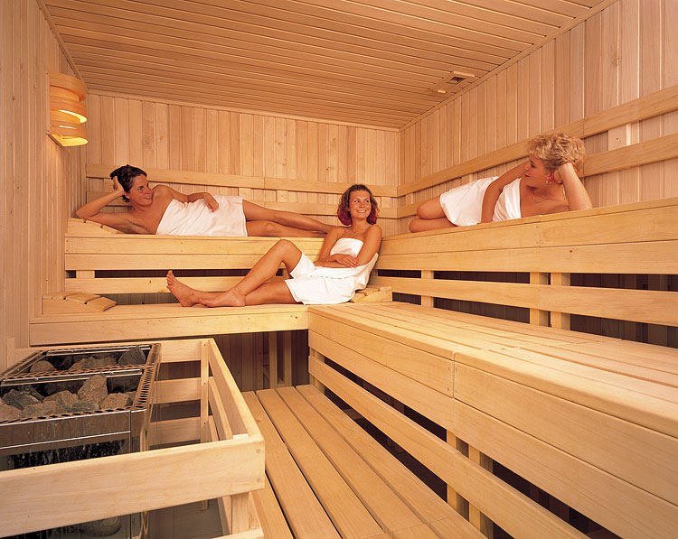

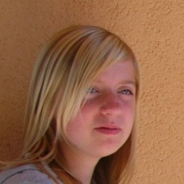
Hi Susan, my name is Irena.
I also like to spend some time here in sauna. We are together here with other women. We chat and lough.
Here You can see hot stones, it makes high temperature . Staying here is good for our health. It makes You fit.

Slide 9
Hey, students! Now underline the chunks, which are used as suggestions. Don´t miss anything.

Slide 10
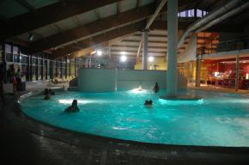

Novák´s with Susan and Hans were in the swimming pool until the evening. They were very tired and thirsty, but very happy.
Jan, I´m sure, they will sleep very well!
Of course we are dad, thank You.
Children, are You tired enough?
Good job, we can return home!

Slide 11
Suggestions-návrhy
We use to offer, suggest to somebody our idea, plan which helps to change his opinion or encourage him to do something.
Používáme k nabídce našeho nápadu, plánu někomu dalšímu, což může vést ke změně jeho názoru nebo dodání odvahy něco udělat.
We use phrases starting with:
Shall we…? Let´s…….. Why don´t we……..?
Focusing on positive feelings: It´s super, relaxive, absolutely perfect, brilliant, wonderful, marvellous!

Slide 12
Some examples of reactions:
Positive: Good idea! I´ll join You. Let´s do it. Let´s go on. It sounds great! etc….
Negative: I´m sorry. I´m afraid it isn´t good idea. Later. No, it´s too dangerous. I´m too…. etc.

